Slide 1

“Your Project Name”
Task - 1

Slide 2
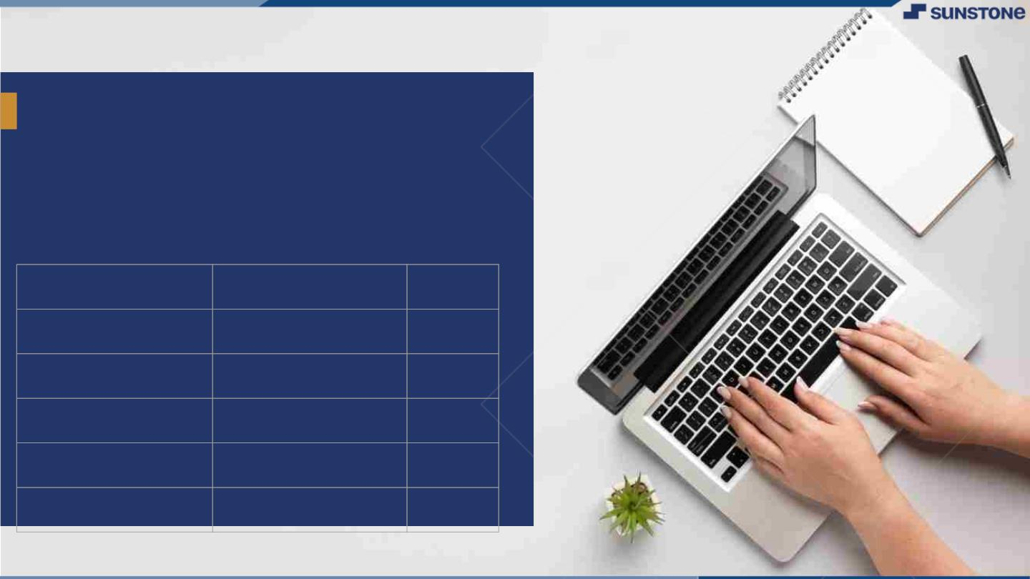
Food delivery website
▪
full stack development project with java
LMS Username | Name | Batch
au310520205301 | Aravindan.G | 02
au310520205302 | Hemanth kumar.D | 02
au310520205303 | Karthick.k | 02
au3110520205045 | Rajamanikandan.k | 02
LMS Username
Name
Batch

Slide 3

Taskꢀ-ꢀ1
CreationꢀofꢀSRSꢀ&ꢀGithub
▪
▪
▪
CreateꢀSRSꢀ:ꢀ“YourꢀProject”
Creationꢀ&ꢀSet-upꢀofꢀGithubꢀaccount
Creationꢀ&ꢀHands-onꢀtoꢀvariousꢀcommandsꢀofꢀGitꢀBash
EvaluationꢀMetric:
● 100%ꢀCompletionꢀofꢀtheꢀaboveꢀtasks
Learning Outcome
▪
▪
▪
▪
Getꢀtoꢀknowꢀaboutꢀdifferentꢀlifecycleꢀmodels.
UnderstandingꢀimportanceꢀandꢀhowꢀtoꢀcreateꢀanꢀSRS
KnowingꢀvariousꢀcommandsꢀofꢀGithub
Understandingꢀagileꢀandꢀscrumꢀmanagementꢀtechniquesꢀforꢀefficientꢀproductꢀdevelopment

Slide 4
Step-WiseꢀDescription
Summaryꢀofꢀyourꢀtask

Slide 5

AssessmentꢀParameter
Gatherꢀrequirementsꢀforꢀtheꢀ
project
addꢀReadme.mdꢀfileꢀwithꢀ
descriptionꢀofꢀtheꢀproject
Prepareꢀdatabaseꢀdesignꢀ
schemas
Check-List
Commitꢀallꢀchangesꢀwithꢀ"firstꢀ
commit"
Getꢀyourꢀinitialꢀprojectꢀ
Structureꢀready
createꢀaꢀrepositoryꢀonꢀgithubꢀ
realtedꢀtoꢀproject
Initiateꢀaꢀgitꢀrepository
Pushꢀyourꢀchangesꢀtoꢀgithub

Slide 6

Submission Github
https://github.com/karthicktheexplorer/NM-DSCET-11.git

Slide 7


